Slide 1
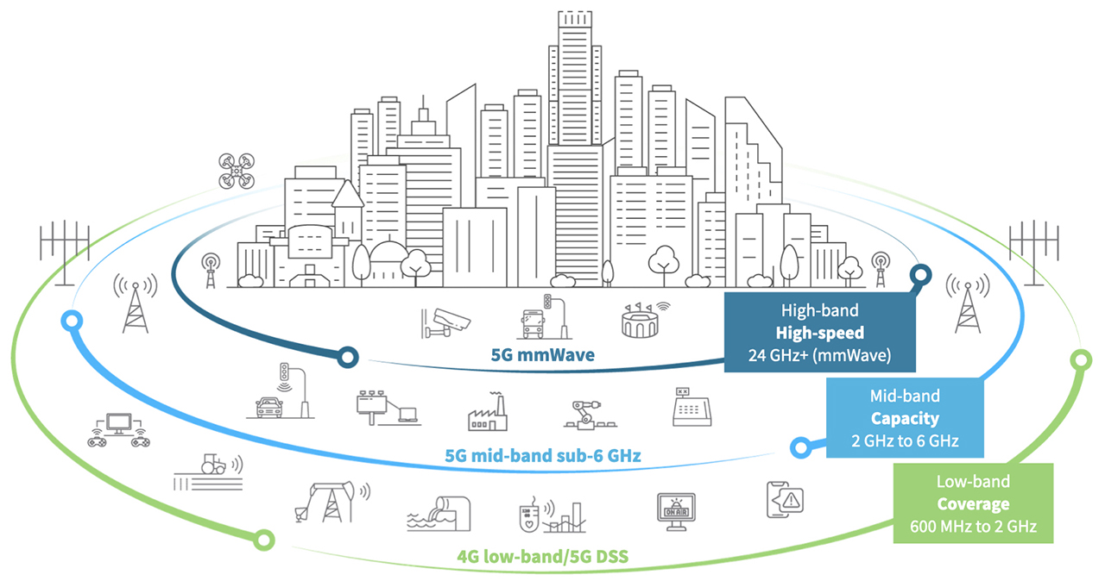
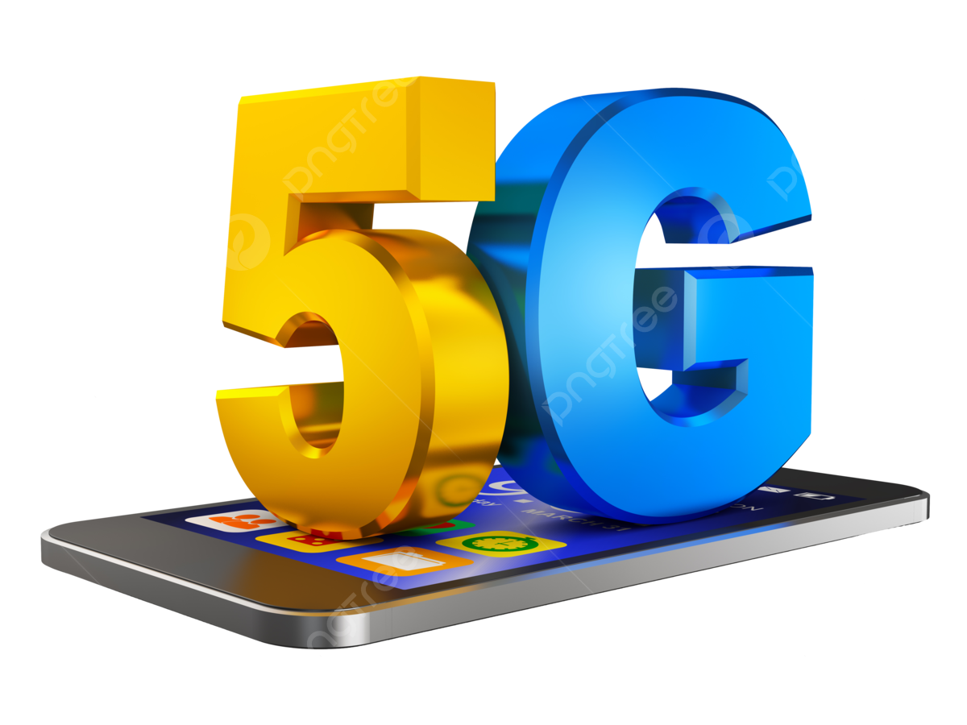
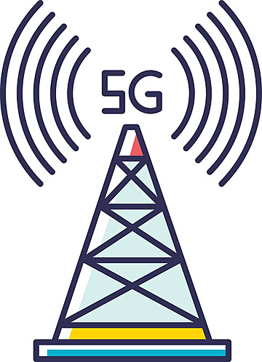
Cisco Packet Tracer: Mobile Tower Network 5G LTE Tech
https://www.youtube.com/watch?v=vuO7QuaKLIg
PDS
Three frequency bands at the core of 5G networks:
5G high-band (mmWave) delivers the highest frequencies of 5G. These range from 24 GHz to approximately 100 GHz. Because high frequencies cannot easily move through obstacles, high-band 5G is short range by nature. Moreover, mmWave coverage is limited and requires more cellular infrastructure.
5G mid-band operates in the 2-6 GHz range and provides a capacity layer for urban and suburban areas. This frequency band has peak rates in the hundreds of Mbps.
5G low-band operates below 2 GHz and provides a broad coverage. This band uses spectrum that is available and in use today for 4G LTE, essentially providing an LTE 5g architecture for 5G devices that are ready now. Performance of low-band 5G is therefore similar to 4G LTE, and supports use for 5G devices on the market today.

Slide 2
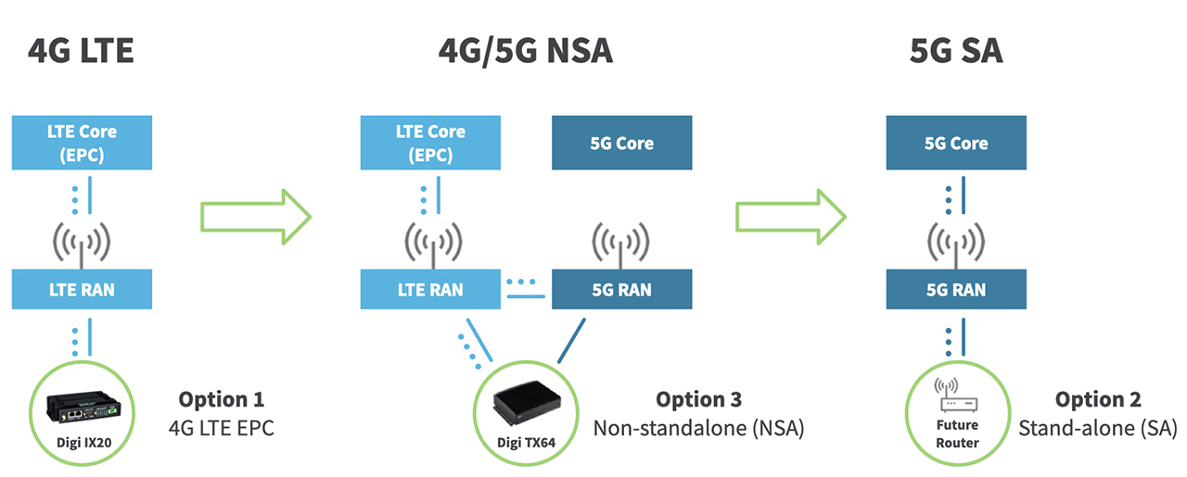
Cisco Packet Tracer: Mobile Tower Network 5G LTE Tech
PDS
The components of the 5G core architecture include:
User plane Function (UPF)
Data network (DN), e.g. operator services, Internet access or 3rd party services
Core Access and Mobility Management Function (AMF)
Authentication Server Function (AUSF)
Session Management Function (SMF)
Network Slice Selection Function (NSSF)
Network Exposure Function (NEF)
NF Repository Function (NRF)
Policy Control function (PCF)
Unified Data Management (UDM)
Application Function (AF)

Slide 3
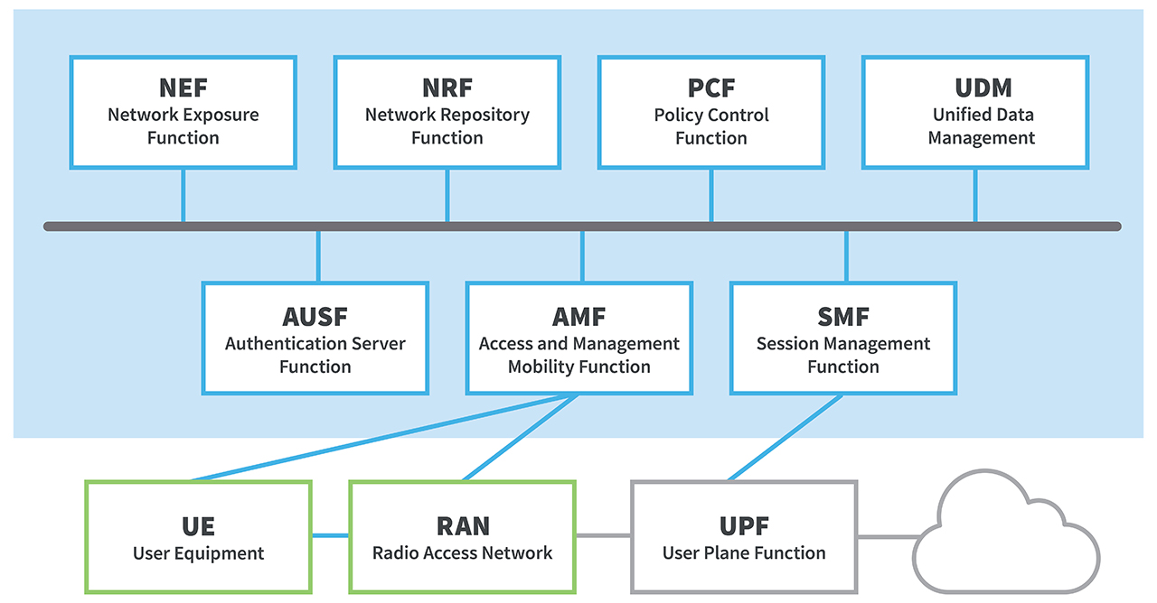
Cisco Packet Tracer: Mobile Tower Network 5G LTE Tech
How it works:
User Equipment (UE) like 5G smartphones or 5G cellular devices connect over the 5G New Radio Access Network to the 5G core and further to Data Networks (DN), like the Internet.
The Access and Mobility Management Function (AMF) acts as a single-entry point for the UE connection.
Based on the service requested by the UE, the AMF selects the respective Session Management Function (SMF) for managing the user session.
The User Plane Function (UPF) transports the IP data traffic (user plane) between the User Equipment (UE) and the external networks.
The Authentication Server Function (AUSF) allows the AMF to authenticate the UE and access services of the 5G core.
Other functions like the Session Management Function (SMF), the Policy Control Function (PCF), the Application Function (AF) and the Unified Data Management (UDM) function provide the policy control framework, applying policy decisions and accessing subscription information, to govern the network behavior.

Slide 4
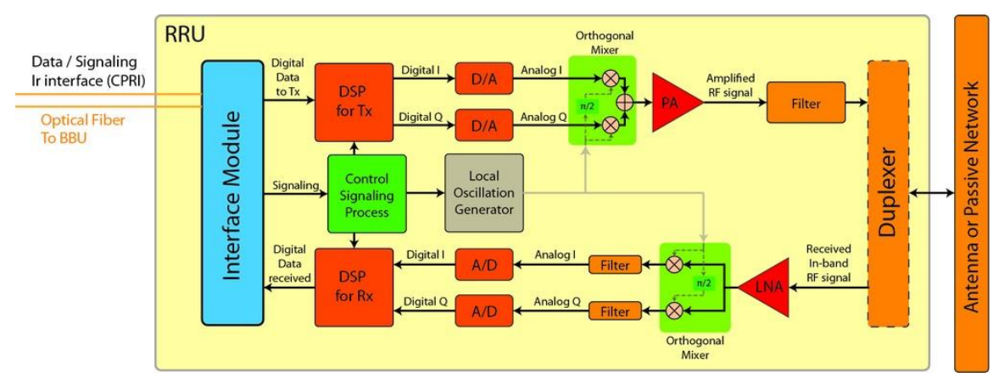
Cisco Packet Tracer: Mobile Tower Network 5G LTE Tech
Radio Remotes
PDS
Jaringan private LTE/ 5G : Sistem terlokalisasi khusus yang menyediakan konektivitas nirkabel masing-masing melalui standar LTE dan 5G. Berbeda dengan jaringan publik yang dioperasikan oleh operator seluler komersial, jaringan pribadi memberikan kendali penuh kepada organisasi – dari awal hingga akhir – atas operasi nirkabel end-to-end mereka. Saat ini, terdapat sekitar 2.200 jaringan 4G LTE pribadi secara global, dan menurut laporan Jaringan LTE/5G Pribadi untuk Aplikasi IoT dari Berg Insights, jaringan LTE/5G pribadi akan tumbuh menjadi 11.900 pada tahun 2028, dengan tingkat pertumbuhan tahunan gabungan (CAGR) sebesar 33. persen.

Slide 5
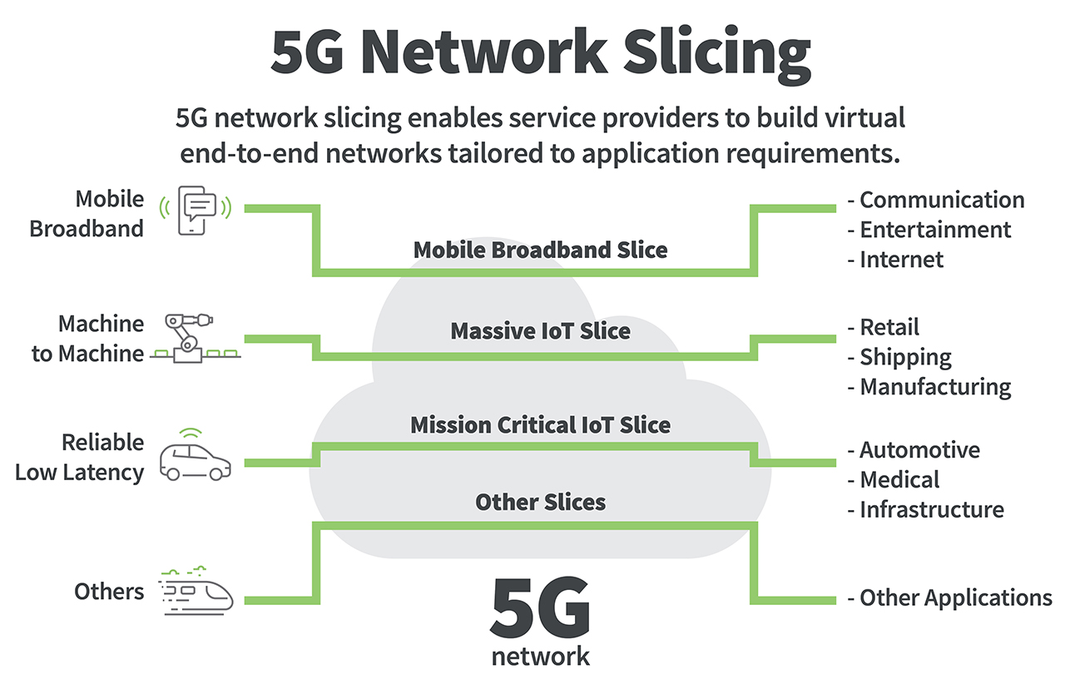
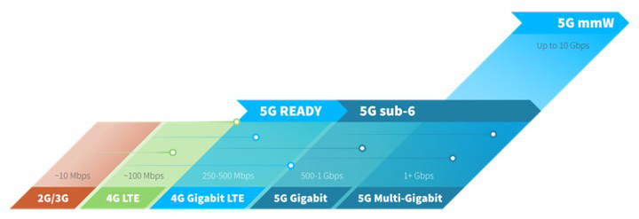
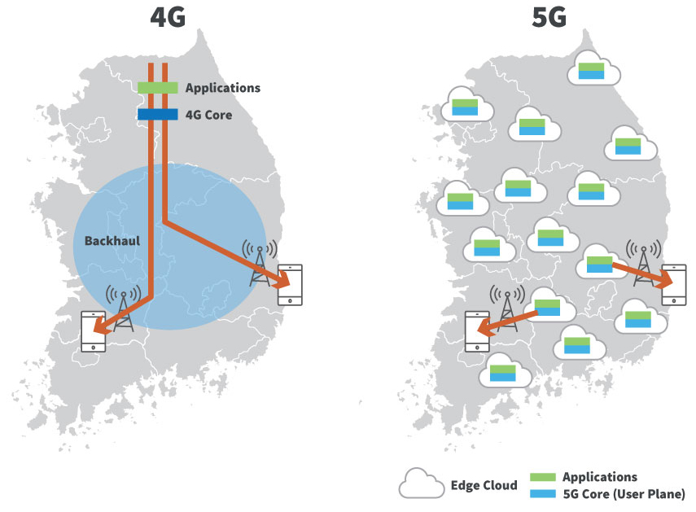
The Evolution of 5G
5G Network Architecture
Ref:
https://www.scribd.com/presentation/356417588/LTE-Long-Term-Evolution-rev-pptx
https://www.itu.int/en/ITU-D/Regional-Presence/AsiaPacific/SiteAssets/Pages/Events/2016/Oct-CandI2016/
https://www.digi.com/blog/post/5g-network-architecture

Slide 6
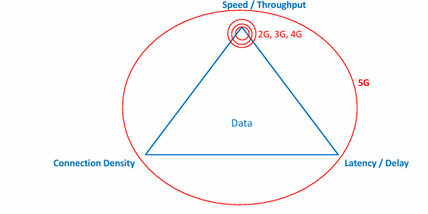
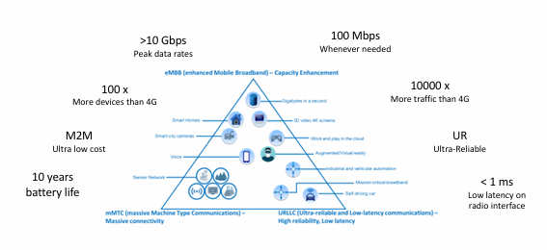
Cisco Packet Tracer: Mobile Tower Network 5G LTE Tech
Focus area for different technology generations
5G High Level Requirements and Wish List

Slide 7
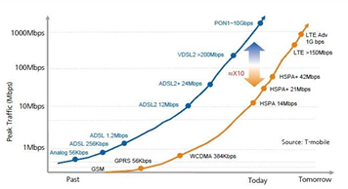
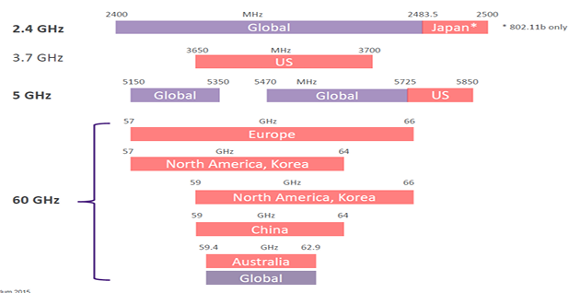
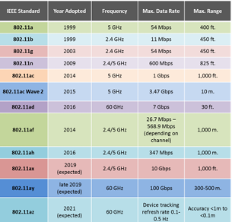
Cisco Packet Tracer: Mobile Tower Network 5G LTE Tech
Evolution of Speeds: Fixed, Wi-Fi & Mobile
Wi-Fi Spectrum around the world

Slide 8
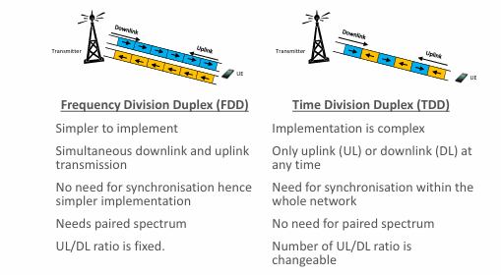
Cisco Packet Tracer: Mobile Tower Network 5G LTE Tech
Bandwidth in mobile networks
The simplest way to understand bandwidth is to think of them as pipes.
The fatter the pipe, the more the bandwidth:
Latency is generally defined as the time it takes for a source to send a packet of data to a receiver. In simple terms, half of Ping time.
This is also referred to as one way latency. Sometimes the term Round trip latency or round trip time (RTT) is also used to define latency.
This is the same as ping time. Jitter is defined as the variation in the delay (or latency) of received packets. It is also referred to as ‘delay jitter’

Slide 9
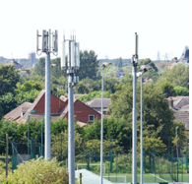
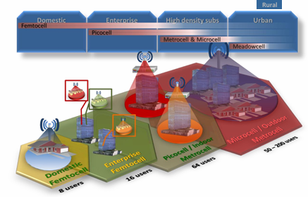
Cisco Packet Tracer: Mobile Tower Network 5G LTE Tech
Types of Small Cells

Slide 10
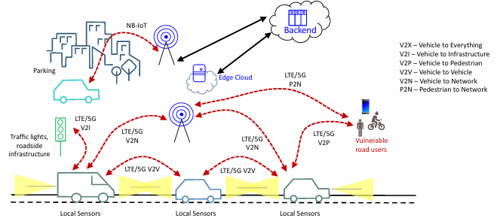
Cisco Packet Tracer: Mobile Tower Network 5G LTE Tech
Cellular V2X Concept

Slide 11
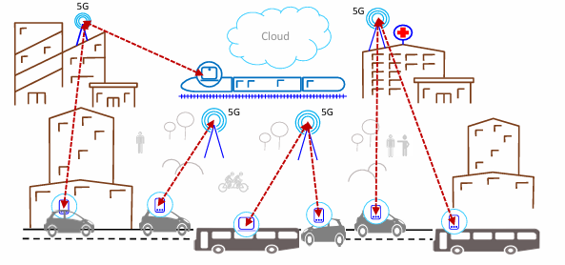
Cisco Packet Tracer: Mobile Tower Network 5G LTE Tech
5G Connected Car: In-vehicle infotainment

Slide 12
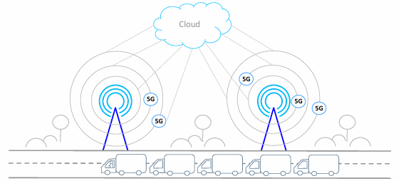
Cisco Packet Tracer: Mobile Tower Network 5G LTE Tech
5G Autonomous Driving: Platooning
5G is the most promising enabler of truck platooning in which long convoys of trucks are automatically governed and require only a single driver in the lead vehicle

Slide 13
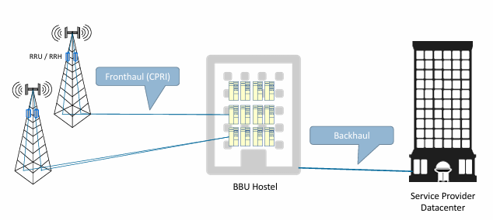
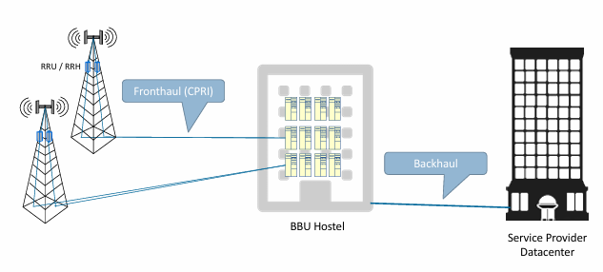
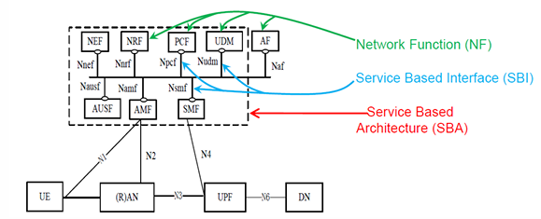
Cisco Packet Tracer: Mobile Tower Network 5G LTE Tech
5GS Service Based Architecture (SBA)
Centralized RAN (C-RAN) / BBU Hostelling
NF – Network Function SBI – Service Based Interface SBA – Service Based Architecture
Baseband Unit (BBU)

Slide 14
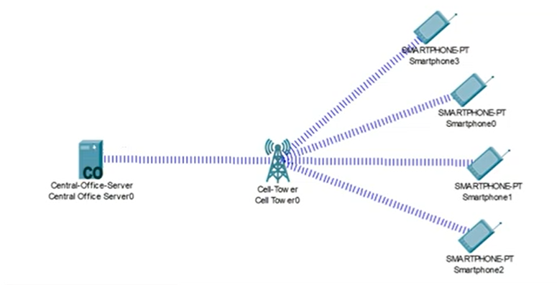
Cisco Packet Tracer: Mobile Tower Network 5G LTE Tech
Youtube L @AmelOline
https://www.youtube.com/watch?v=vuO7QuaKLIg

Slide 15
Thank You
Notes:
https://red-colmena.com/f/JyY1ajY1JmhhZSFpdC91JGcmIyEsYGU/18/08/cw_5g_training_v3_slides.pdf
https://www.youtube.com/watch?v=vF2fV_gJ81g

